Slide 1
8th Grade MENU projects
Mr. Murray’s 8M projects

Slide 2
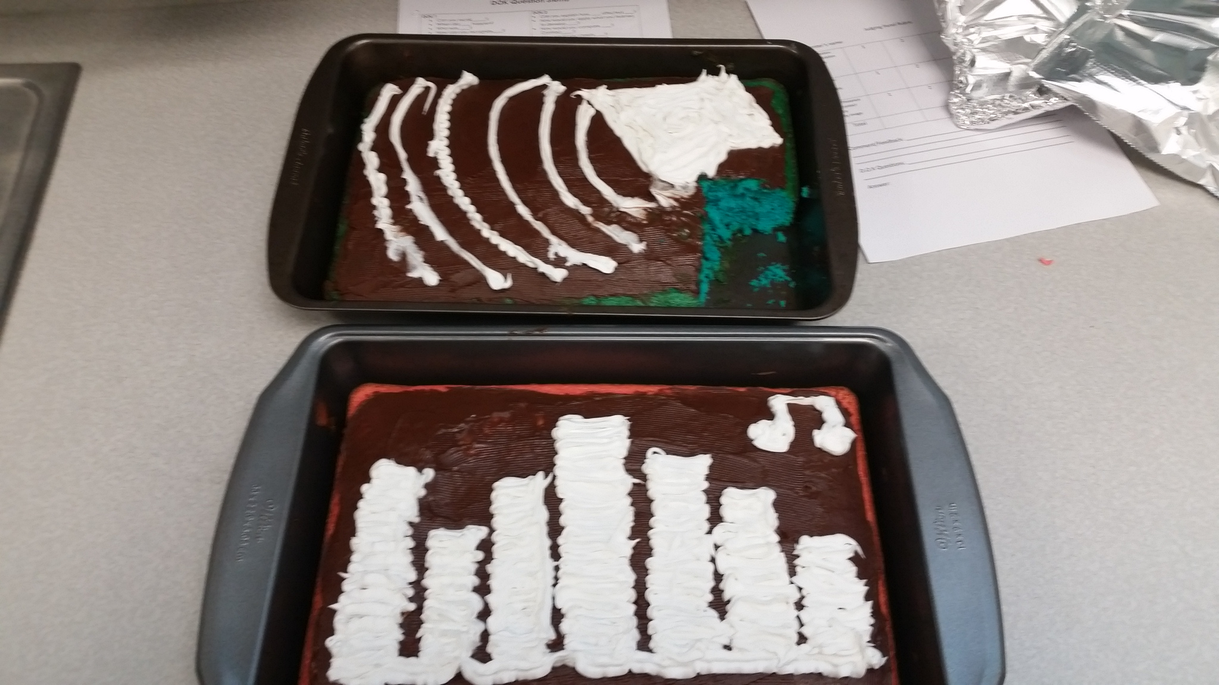
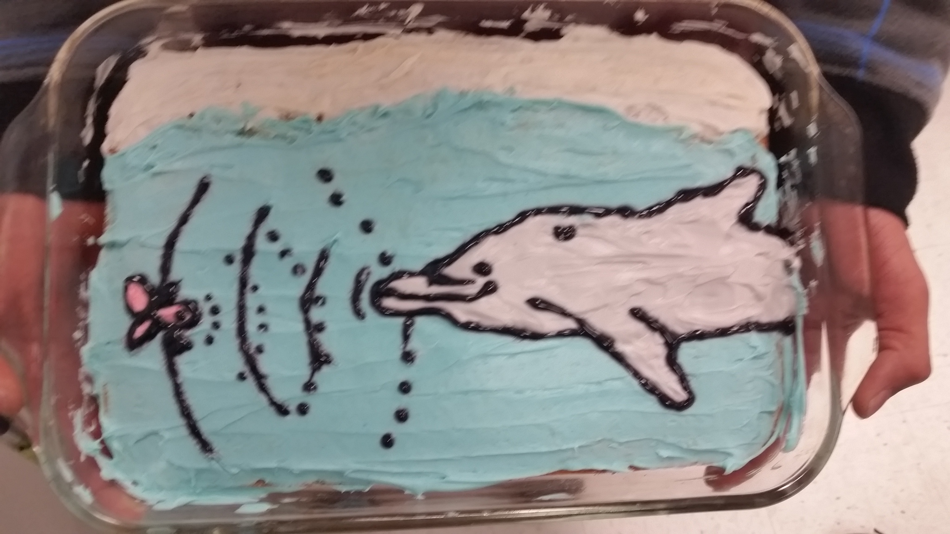
Students created some great models
Some great visualizations of sound waves
Echolocation

Slide 3
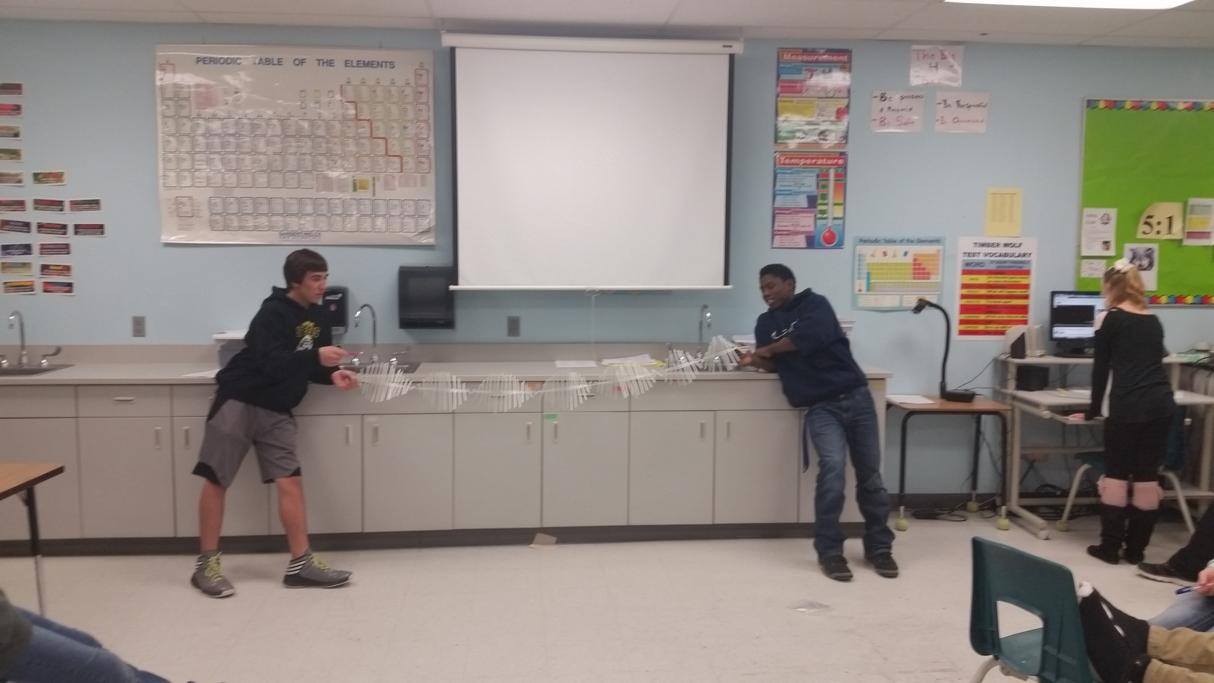
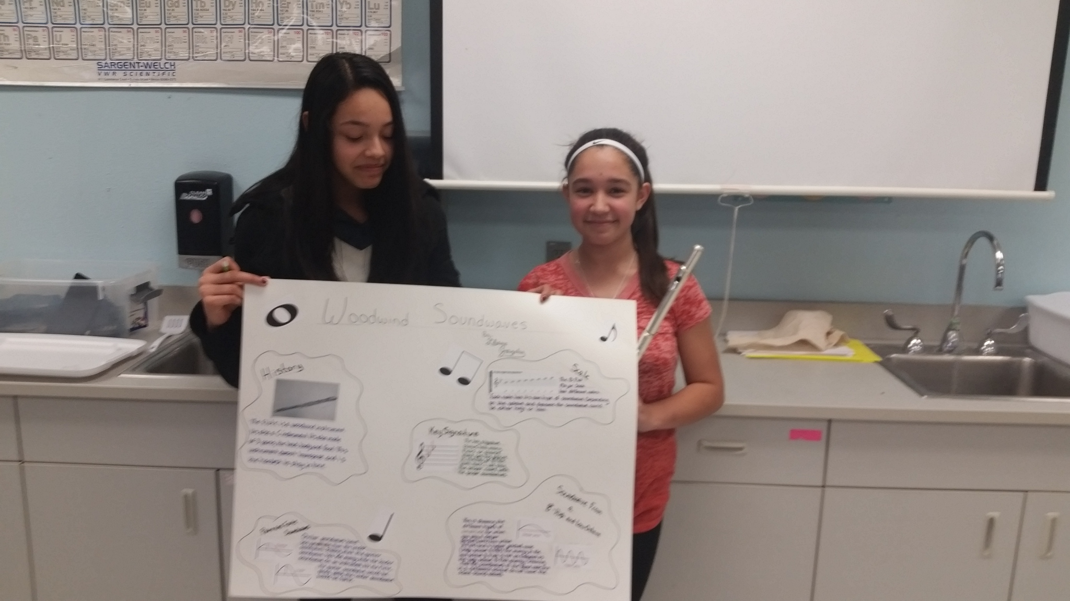
Models, models and models
A transverse wave in action
Learning how a flute works

Slide 4
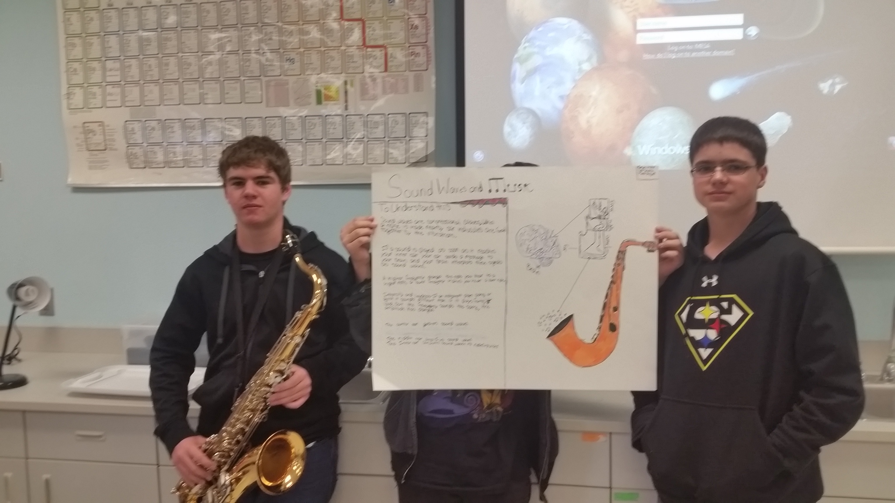
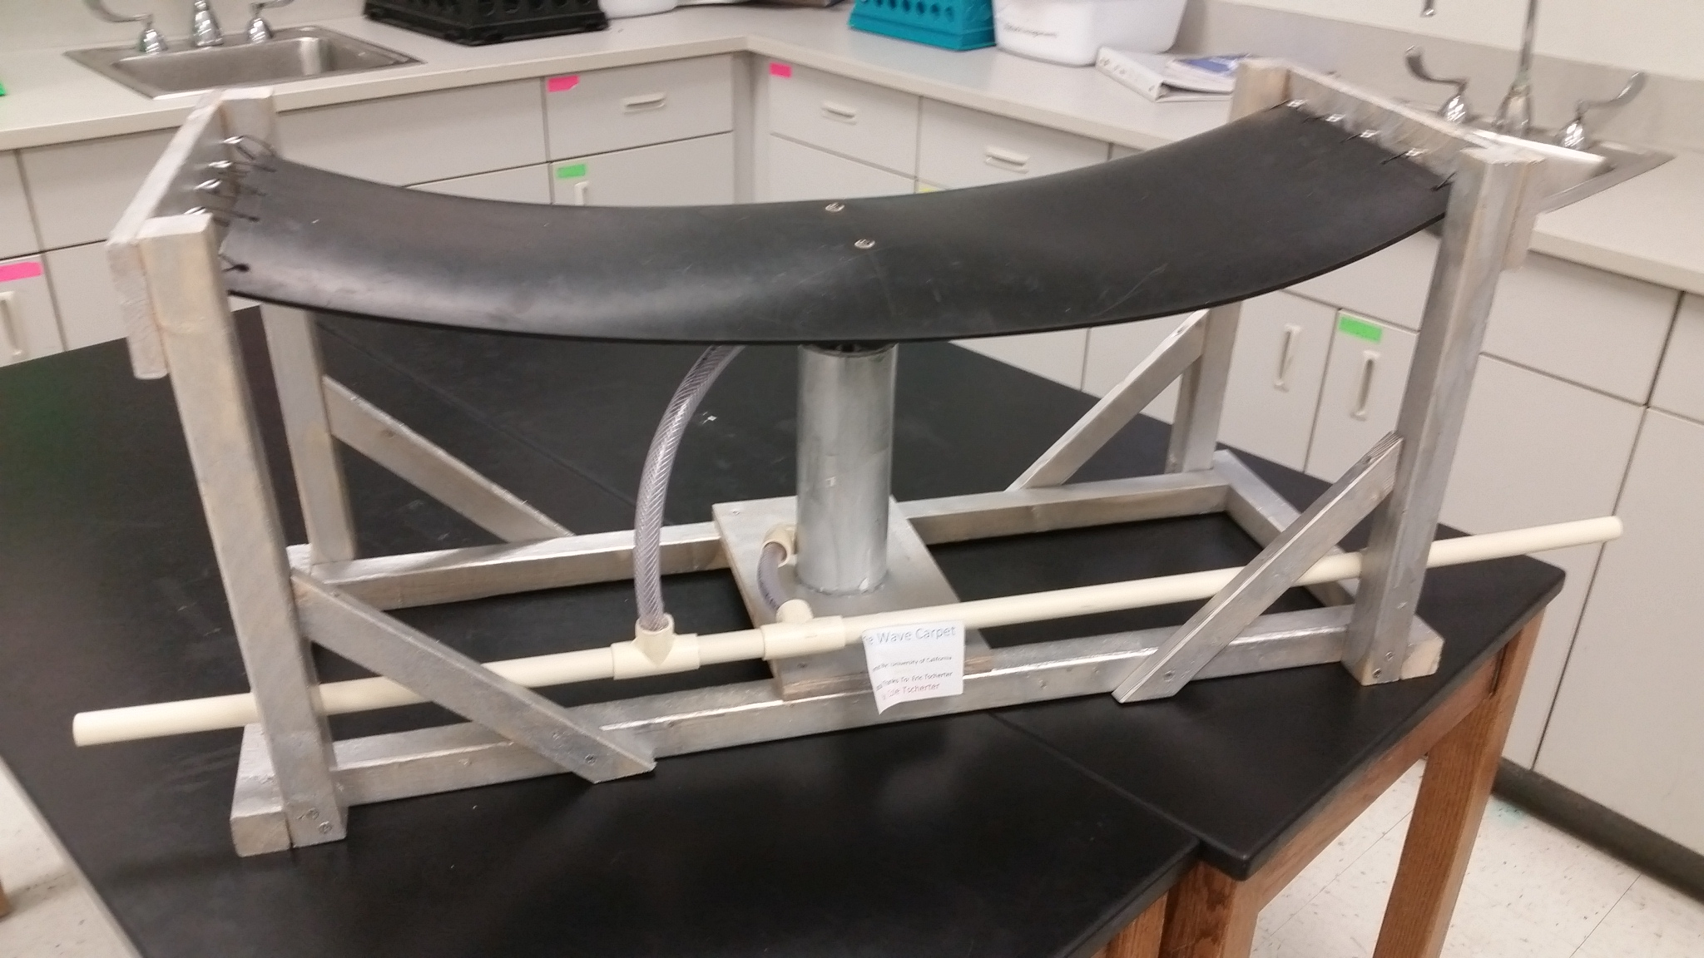
Very creative
Kenny G might have some competition
Have you ever seen a wave carpet?

